Slide 1
Java Programming
Classes & Objects

Slide 2
Outline
Object oriented programming
Class declaration
Constructing objects with new
Some special classes
Nested classes
local classes
anonymous classes
Modeling & UML

Slide 3
Object oriented programming
Recall:
We use the variables studentId, weight, height to store the information of one student.
Then we use the arrays studentId[], weight[], height [] to store the information of all the students.
Is it a good way?

Slide 4

Object oriented programming
In classic procedural programming you try to make the real world problem you're attempting to solve fit a few, predetermined data types: integers, floats, Strings, and arrays perhaps.
In object oriented programming (OOP) you can create a model for a real world system.

Slide 5
Object oriented programming
Classes are programmer-defined types that model the parts of the system.
A class has two parts: the fields and the methods.
Fields describe what the class is.
Methods describe what the class does.
Using the blueprint provided by a class, you can create any number of objects, each of which is called an instance of the class.

Slide 6

Object oriented programming
Look inside the object
Different objects of the same class have the same fields and methods, but the values of the fields will in general differ.
Every object has a separate block of memory to store its fields, but the bytes in the methods are shared between all objects in a class.

Slide 7
Defining a class
public class Student{
private String id; //10 digital charactors, like 1160611003
private String name;
private double weight; //in kilograms
private double height; //in meters
private static int studentNum;
private final static String school = “HIT”;
public Student(String id,String name,double height, double weight){
…
}
…
}
Note the use of comments to specify the units. That's important. A unit confusion between pounds and newtons led to the loss of NASA's $94 million Mars Climate Orbiter.

Slide 8
Class declarations
In general, class declarations can include these components, in order:
Modifiers such as public, private, and a number of others that you will encounter later.
The class name, with the initial letter capitalized by convention.
The class body, surrounded by braces, {}.
we will introduce advanced class declaration options later.

Slide 9
Kinds of Variables
Member variables
declared inside a class definition.
local variables
declared inside a method.
created when a method is invoked, and their space is reclaimed when the method ends.
Parameters
variables in method declarations.
Their lifetime are the same with local variables.

Slide 10
Member variables
Member variables are also called fields.
They are declared in a class definition, usually before the method definitions.
Field declarations are composed of three components, in order:
Zero or more access modifiers, such as public or private.
The field's type.
The field's name.

Slide 11
Access Modifiers
Access Modifiers lets you control what other classes have access to a member field or method. There are four access modifiers:
no explicit modifier
the field or method is accessible from the package, the default access modifier.
public modifier
the field or method is accessible from all classes.
private modifier
the field or method is accessible only within its own class.
protected modifier
the field or method is accessible only within its own package.

Slide 12
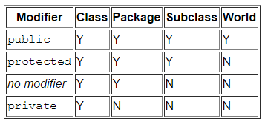
Access Modifiers
There are two levels of access control:
At the top (class) level—public, or package-private (no explicit modifier).
At the member level—public, private, protected, or package-private (no explicit modifier).

Slide 13
Tips on choosing access modifiers
Use private unless you have a good reason not to. Avoid public fields except for constants.
Access modifiers help keep classes isolated from each other so that changes in one class won’t require changes in other classes. This kind of isolation is called information hiding.
Notice: Many of the examples in the lectures use public fields. This may help to illustrate some points concisely, but is not recommended for production code.

Slide 14
Other modifiers
static modifier
the field or method is accessible only within its own class. and, in addition, by a subclass of its class in another package.
final modifier
You can declare a class, a variable or a method to be final.
A final method cannot be overridden in the subclass.
A final variable cannot be re-assigned a new value.
A final class cannot be sub-classed (or extended)
we will discuss this in the future.

Slide 15
Kinds of member variables
There are two kinds of member variables:
Instance variables
Class variables

Slide 16
Instance variables
Instance variables are fields without static modifier.
When a number of objects are created from the same class blueprint, they each have their own distinct copies of instance variables.
They are created when you construct an object and reclaimed when the object is garbage-collected.

Slide 17
Class variables
Class variables are identified by the keyword static.
Class variables are also called static fields.
Class variables are shared across all instances of the class.
They are created when the program begins (or when the class is used for the first time) and survive until the program ends.

Slide 18
What is the output?
class Counter{
int count=0; //will get memory when instance is created
Counter(){
count++;
System.out.println(count);
}
public static void main(String args[]){
Counter c1=new Counter();
Counter c2=new Counter();
Counter c3=new Counter();
}
}

Slide 19
What is the output?
class Counter2{
static int count=0;//will get memory only once and retain its value
Counter2(){
count++;
System.out.println(count);
}
public static void main(String args[]){
Counter2 c1=new Counter2();
Counter2 c2=new Counter2();
Counter2 c3=new Counter2();
}
}

Slide 20
Constants
The static modifier, in combination with the final modifier, is also used to define constants.
By convention, the names of constant values are spelled in uppercase letters. If the name is composed of more than one word, the words are separated by an underscore (_).
If a primitive type or a string is defined as a constant and the value is known at compile time, the compiler replaces the constant name everywhere in the code with its value.

Slide 21
Member Methods
After declaring the member variables, the next step is to define the member methods that manipulate the member variables.

Slide 22
Method declarations
Method declarations are composed of six components, in order:
Zero or more access modifiers.
The method's return type.
The method's name.
The parameter list in parenthesis.
An exception list — to be discussed later.
The method body, enclosed between braces.
Like the member variables, member methods can also be divided into two kinds:
Instance method
Class method (or static method)

Slide 23
Access control
Instance methods
Instance methods can access instance variables and instance methods directly.
Instance methods can access class variables and class methods directly.
Class methods
Class methods can access class variables and class methods directly.
Class methods cannot access instance variables or instance methods directly. Also, class methods cannot use the this keyword as there is no instance for this to refer to.

Slide 24
Refactor the BMI classes
public class BMI {
private Student[] students;
public void genStudents(){…}
public void sortStudentbyHeight(){…}
…
public void showStudents(){…}
public static void main(String[] args) {
BMI bmi = new BMI();
bmi.genStudents()
bmi.sortStudentbyHeight();
bmi.showStudents();
}
}

Slide 25
Generate students randomly
public Student[] genStudents(int N) {
Student students[] = new Student[N];
Random r = new Random();
double x=0.0,y=0.0;
for(int i=0;i<200;i++){
x=r.nextGaussian();
Student st= new Student(
String.format("%04d",i),
genRandomString(6),(1.75+x*0.1),(60.0+y*5));
students.add(st);
}
return students;
}

Slide 26
Generate student’s name randomly
public String genRandomString(int length){
String str= "ABCDEFGHIJKLMNOPQRSTUVWXYZ";
Random random=new Random();
StringBuffer sb=new StringBuffer();
for(int i=0;i<length;i++){
int number=random.nextInt(26);
sb.append(str.charAt(number));
}
return sb.toString();
}

Slide 27
Encapsulation
So far, we have introduce one of three very important features about OOP, which is called encapsulation.
A language construct that facilitates the bundling of data with the methods (or other functions) operating on that data .
A language mechanism for restricting direct access to some of the object's components.
Encapsulation is often used interchangeably with information hiding.
https://en.wikipedia.org/wiki/Encapsulation_(computer_programming)
https://en.wikipedia.org/wiki/Information_hiding

Slide 28
Constructor
A constructor creates a new instance of the class. It initializes all the variables and does any work necessary to prepare the class to be used.
Constructor declarations look like method declarations—except that they use the name of the class and have no return type.
However if you do nothing, then the compiler inserts a default constructor that takes no arguments.

Slide 29
Keyword this and dot notation
Within an instance method or a constructor, this is a reference to the current object — the object whose method or constructor is being called.
To access an attribute or a method of an object, Java uses dot notation.

Slide 30
Constructor
public Student(String id, String name, double height, double weight){
this.id = id;
this.name = name;
this.weight =weight;
this.height = height;
studentNum++;
}
public Student(String id){
this.id = id;
studentNum++;
}

Slide 31
Overloading
If two methods do the same thing, it is natural to give them the same name.
Having more than one method with the same name is called overloading, and it is legal in Java as long as each version takes different parameters.

Slide 32
Constructing objects with new
To instantiate an object in Java, use the keyword new followed by a call to the class's constructor.
Student s = new Student(“1160611003”);
Student s = new Student(“1160611004”,”Donald Trump”,1.86,75.5);

Slide 33
The null value
When you create an object variable, remember that you are storing a reference to an object.
In Java, the keyword null is a special value that means “no object”. You can declare and initialize object variables this way:
Student s = null;
And you can use bellow expression to check where an object is null
s==null
If you try to use a null value, either by accessing an attribute or invoking a method, Java throws a NullPointerException (an runtime error).

Slide 34
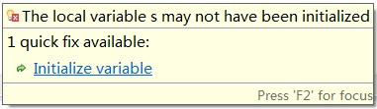
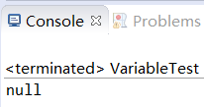

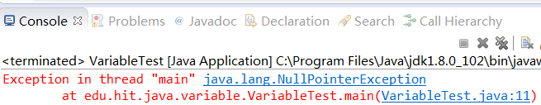
Analysis below statements
String s;
System.out.println(s);
s=null;
System.out.println(s);
System.out.println(s.toString());
Notes:
Notice: Variables must be initialized (assigned for the first time) before they can be used!

Slide 35
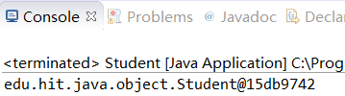
Anonymous Objects
Objects without their declarations known as Anonymous Objects.
They are known as use & throw objects because these are died after one time use.
For example
(new student(“1160611003”)).toString();

Slide 36
The toString method
Every object type has a method called toString that returns a string representation of the object.
When you display an object using print or println, Java invokes the object’s toString method.
By default it simply displays the type of the object and its address, but you can override this behavior by providing your own toString method.
Notice: It is an instance method

Slide 37
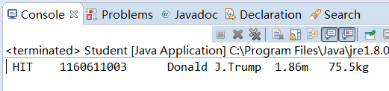
The toString method
public String toString(){
return String.format(" %s \t%s \t%s \t%03.2fm %04.1fkg”, this.school, this.id, this.name, this.height, this.weight);
}
public static void main(String[] args) {
Student s = new Student("1160611003");
s.setName("Donald J.Trump");
s.setHeight(1.86);
s.setWeight(75.5);
System.out.println(s);
}

Slide 38
The setter and getter methods
In general, almost all member variables should be declared private, then you can use setters and getters to access the member variables as required.
public void setName(String name) {
this.name=name;
}
public void getName() {
return name;
}
public void setHeight(double height) {
this.height=height;
}
public void getHeight() {
return this.height;
}
…

Slide 39
Debate on setters and getters
Reasons to Support
Reducing the scope (visibility) of data as much as possible led to more reliable and maintainable code
This gives you complete control over what can be done with the variable.
…
Reasons to oppose
A profusion of getters and setters is a sign of a poorly-designed set of classes.
They are a waste of CPU time, but more important, they are a waste of programmer time.
…
Notes:
http://www.javaworld.com/article/2073723/core-java/why-getter-and-setter-methods-are-evil.html
http://typicalprogrammer.com/doing-it-wrong-getters-and-setters/

Slide 40
The equals method
The == operator checks whether objects are identical; that is, whether they are the same object.
The equals method checks whether they are equivalent; that is, whether they have the same value.

Slide 41


Determine whether two students are the same person
public boolean equals(Student that) {
return this.id == that.id;
}
public boolean equals(Student that) {
return this.id.equals(that.id);
}

Slide 42
Quiz: define your own Date class
Write a class definition for Date, an object type that contains three integers: year, month, and day.
The constructor take parameters named year, month and day, and use them to initialize the instance variables.
Provide the equals method to determine whether two Date objects are equal.
Provide the toString method to print the date using the date format in Chinese (e.g. “2017年9月1日”).
Test the above methods in the main method.

Slide 43
Nested Classes
Java allows you to define a class within another class. Such a class is called a nested class.
Nested classes are divided into two categories: static and non-static.
Nested classes that are declared static are called static nested classes.
Non-static nested classes are called inner classes.

Slide 44
Nested Classes
class OuterClass {
...
static class StaticNestedClass {
...
}
class InnerClass {
...
}
}

Slide 45
Nested Classes
A nested class is a member of its enclosing class.
A nested class can be declared private, public, protected, or package private. (Recall that outer classes can only be declared public or package private.)
Notice:
inner classes have access to other members of the enclosing class, even if they are declared private.
Static nested classes do not have access to other members of the enclosing class.

Slide 46
Initialize Nested Classes
public class BMI{
...
public void BMI() {
...
HeightComparator hc = new HeightComparator();
…
}
public static void main(String[] args) {
BMI bmi = new BMI();
bmi.sortStudents( bmi.new HeightComparator());
…
}
private class HeightComparator{
...
}
}

Slide 47
Local classes
Local classes are classes that are defined in a block , rather than as a member of a class.
Notice: A local class may also has access to the members of its enclosing class.

Slide 48
Anonymous Classes
Anonymous classes enable you to declare and instantiate a class at the same time.
Anonymous are like local classes except that they do not have a name. Use them if you need to use a local class only once.
We will introduce it in GUI programming.

Slide 49
Reading materials
http://docs.oracle.com/javase/tutorial/java/javaOO/nested.html
http://docs.oracle.com/javase/tutorial/java/javaOO/localclasses.html
http://docs.oracle.com/javase/tutorial/java/javaOO/anonymousclasses.html

Slide 50

Modeling & UML
Modeling is the designing of software applications before coding. Modeling is an Essential Part of large software projects, and helpful to medium and even small projects as well.
Unified Modeling Language (UML) helps you specify, visualize, and document models of software systems, including their structure and design.
UML standards are maintained by OMG (Object Management Group, Inc.)

Slide 51
UML
UML 2.0 defines thirteen types of diagrams, divided into three categories:
Structure Diagrams include
the Class Diagram, Object Diagram, Component Diagram, Composite Structure Diagram, Package Diagram, and Deployment Diagram.
Behavior Diagrams include
the Use Case Diagram (used by some methodologies during requirements gathering); Activity Diagram, and State Machine Diagram.
Interaction Diagrams (all derived from the more general Behavior Diagram) include:
the Sequence Diagram, Communication Diagram, Timing Diagram, and Interaction Overview Diagram.
Notes:
http://www.uml.org/what-is-uml.htm#12DiagramTypes

Slide 52
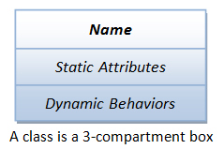
Class diagram
In UML, a class can be visualized as a three-compartment box, as illustrated:
Notice: the word “static” here is not the java keyword “static”!

Slide 53
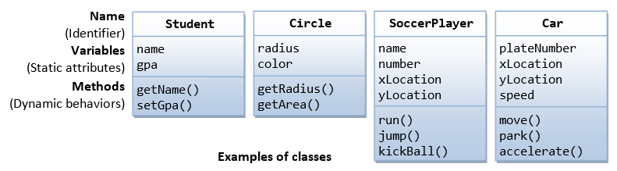
Class diagram
The followings figure shows a few examples of classes:
http://www.ibm.com/developerworks/rational/library/content/RationalEdge/sep04/bell/
http://www.sparxsystems.com.au/resources/uml2_tutorial/uml2_classdiagram.html

Slide 54
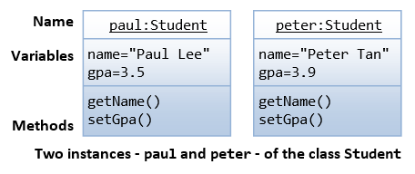
Object diagram
An instance is also represented as a 3-compartment box, with instance name shown as instanceName: Classname and underlined.

Slide 55
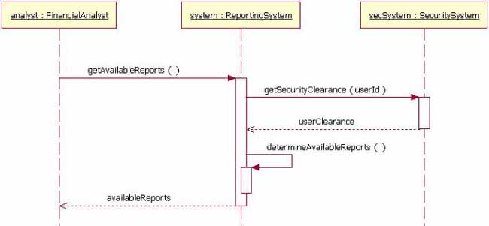
Sequence Diagram
A Sequence diagram is an interaction diagram that shows how objects operate with one another and in what order.
instance
message
object lifeline
method-invocation box
return message
http://www.ibm.com/developerworks/rational/library/3101.html
http://www.sparxsystems.com.au/resources/uml2_tutorial/uml2_sequencediagram.html

Slide 56


